Slide 1

Angular lecture 7 Animations

Slide 2
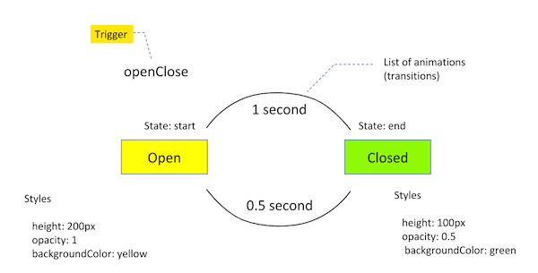
Animations

Slide 3
Public Animation
import { trigger, state, style, transition, animate } from '@angular/animations‘
export let fade=trigger('fade',[
transition(':enter , :leave',[ animate(1000,style({opacity:0})) ])
]);
export let openClose=trigger('openClose',
[
state('open', style({ height: '200px', opacity: 1, backgroundColor: 'yellow' })),
state('closed', style({ height: '100px', opacity: 0.5, backgroundColor: 'green' })),
transition('open => closed', [ animate('1s') ]), transition('closed => open', [ animate('0.5s') ]),
]);
export let marquee=trigger('marquee',
[
state('left',style({ transform : 'translateX(0px)', "background-color": "#FF6868" })),
state('right',style({ transform : 'translateX(1000px)', "background-color": "#FFF" })),
transition('left <=> right',animate('3500ms ease-in'))
])

Slide 4
Used animations
import { Component } from '@angular/core';
import { marquee, fade, openClose } from 'src/app/Animations/animations';
@Component({
selector: 'app-animate',
templateUrl: './animate.component.html',
styleUrls: ['./animate.component.css'],
animations: [ marquee,fade,openClose ]
})
export class AnimateComponent {
stydents:Array<string>=["ssss","aaaa","ssssaaa"];
marqueeDirection: string = "left";
isOpen:boolean=true;
fadeStatus:string="enter"
fade(){
if( this.stydents.length>1)
this.stydents=[];
else
this.stydents=["ssss","aaaa","ssssaaa"];
}
openClose() {
this.isOpen = !this.isOpen;
}
marquee() {
this.marqueeDirection= this.marqueeDirection == 'right' ? 'left' : 'right';
}
toggle(){
this.openClose()
this.marquee()
this.fade()
}
}

Slide 5
<div>
<button (click) = "toggle()" class="btn btn-primary">
animations toggle
</button>
<hr>
<div [@marquee] = "marqueeDirection" class="rotate">
<h1>Tarek Sherif</h1>
</div>
</div>
<ul>
<li [@fade]="fadeStatus" *ngFor="let stu of stydents "> {{stu}} </li>
</ul>
<div [@openClose]="isOpen ? 'open' : 'closed'" class="open-close-container" >
<p>The box is now {{ isOpen ? 'Open' : 'Closed' }}!</p>
</div>

